Slide 1


UNIVERSITY COLLEGE OF ENGINEERING,
OSMANIA UNIVERSITY
DEPARTMENT OF BIOMEDICAL ENGINEERING
PUPILLOMETER FOR AUTOMATED DETECTION OF RELATIVE AFFERENT PUPILLARY DEFECT
INTERNAL GUIDE :
Associate Prof: DR.D.SUMAN
TEAM MEMBERS :
PAVANI THADEM –100519731022
CHILMULA DHARANI – 100519731082
SRIVOJU VAISHNAVI –100519731084

Slide 2
Project analysis slide 2
Contents
FUTURE DEVELOPMENTS
OBJECTIVES
PROJECT
CURRENT PROGRESS
INTRODUCTION
1

Slide 3
Objectives
To detect RAPD by estimating the radii of the pupil in constricted mode.
To reduce the effort of technicians by making it real-time.
To include the grading system according to pupil response.
2

Slide 4
Introduction
Relative Afferent Pupillary Defect (RAPD) indicates serious ocular disease. It is caused due to any damage to the Afferent pupillary pathways that are responsible for transmitting signals from the eye to the brain.
SFT has been a traditional way of testing for RAPD for decades, as there is no quantification and being a subjective test, the assessment depends on the experience of the clinician.
Advantages of pupillometer over SFT :
Technicians should be trained and well experience to interpret the results obtained from SFT, whereas newly trained can perform the test using a pupillometer.
Pupillometer can be performed in both light and dark environments.
3

Slide 5
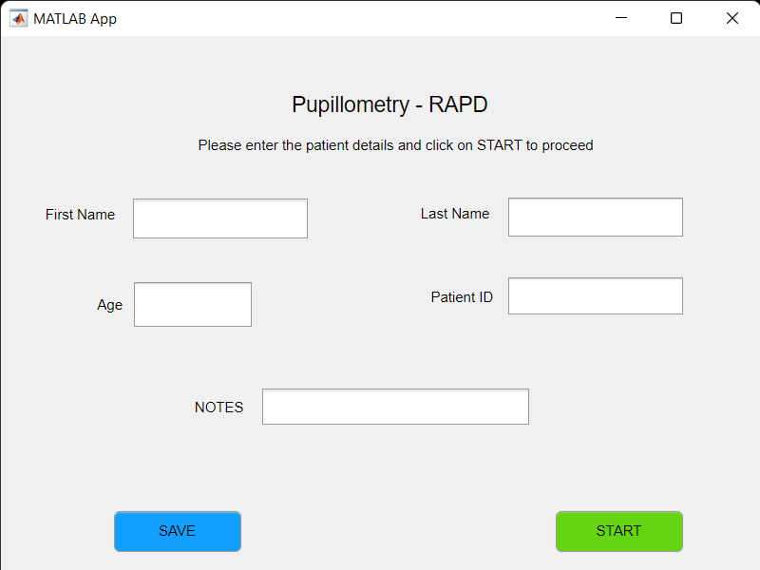

Current Progress
4

Slide 6
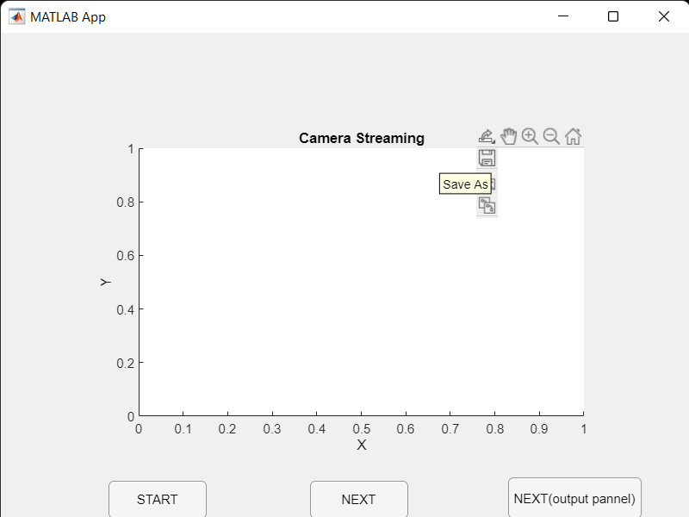
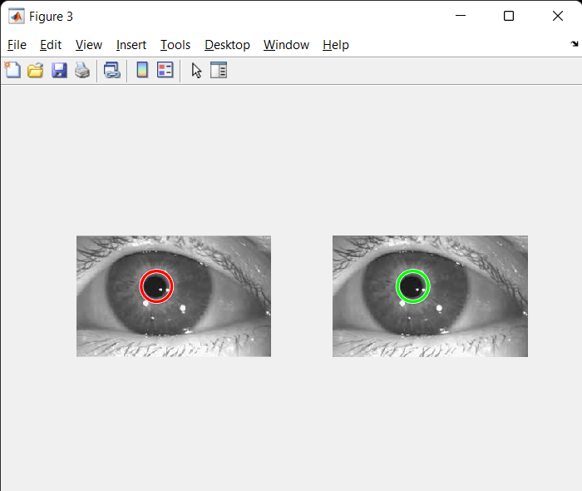
Current Progress
5

Slide 7
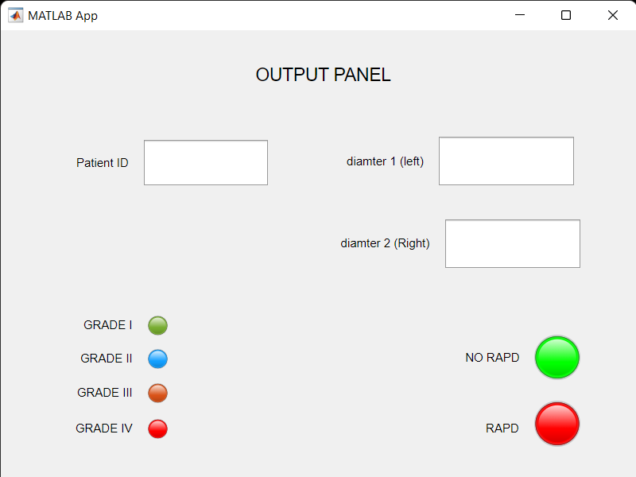
Future Developments
6

Slide 8
THANK YOU

